Slide 1
Hide Data in images using Steganography
CAPSTONE PROJECT
Presented By:Yogesh Uddalsing Rajput
Student Name : Yogesh Rajput
College Name & Department : Government College Of Engineering Nagpur / Elecrical Engineering

Slide 2
OUTLINE
Problem Statement
Technology used
Wow factor
End users
Result
Conclusion
Git-hub Link
Future scope

Slide 3
Problem Statement
In today’s digital age, ensuring data security and privacy is a top priority. Traditional encryption methods are often prone to detection and interception. Our project tackles this challenge by using steganography to hide secret messages within images. This method offers a covert communication channel, enhancing data confidentiality without raising suspicion.

Slide 4
Technology used
Programming Language: Python
Libraries:
OpenCV for image processing
Tkinter (with ttk) for the GUI
NumPy for efficient array manipulation
Platform: Cross-platform (Windows/Linux)
Tools: Visual Studio Code

Slide 5
Wow factors
Implements robust LSB steganography that embeds both the passcode and message length in the image header.
Uses lossless PNG format to preserve hidden data integrity.
Features a modern, user-friendly GUI for both encryption and decryption processes.
Combines advanced image processing techniques with secure data transmission.

Slide 6
End users
Security professionals and cybersecurity enthusiasts.
Journalists, activists, and government agencies needing secure communication channels.
Students and researchers interested in data privacy and steganography.
General users looking for enhanced digital security.

Slide 7
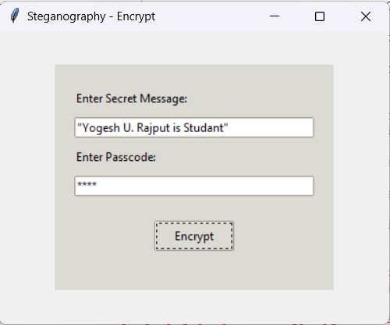
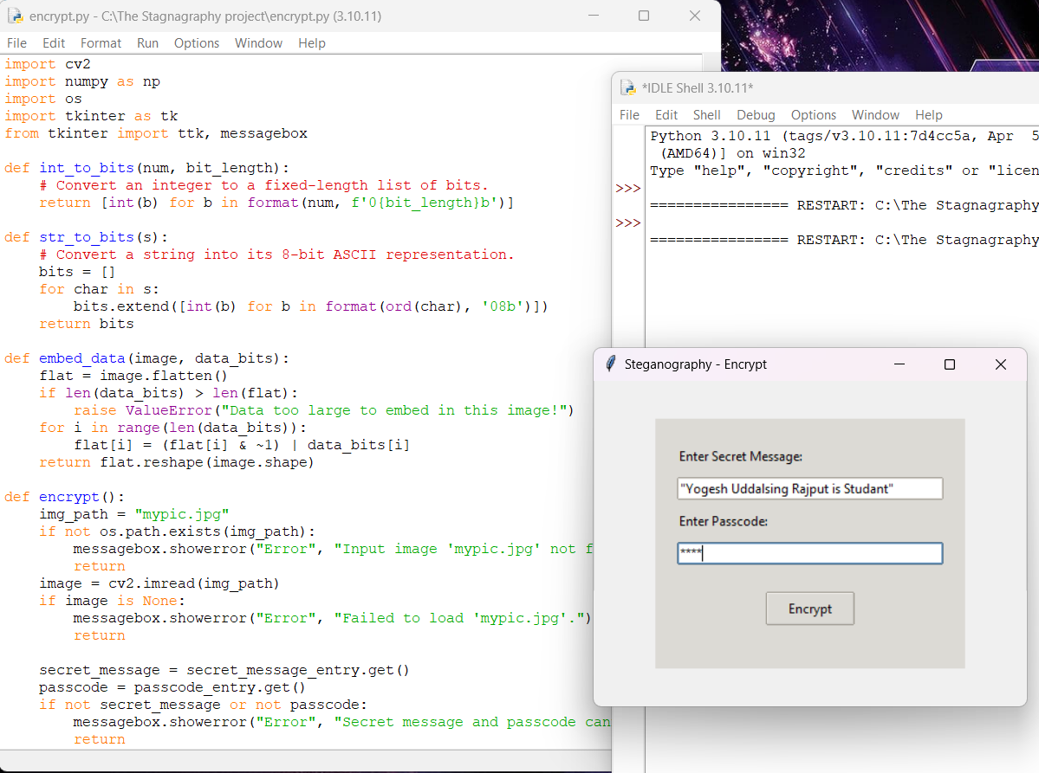
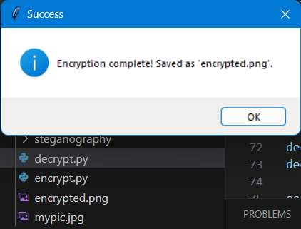
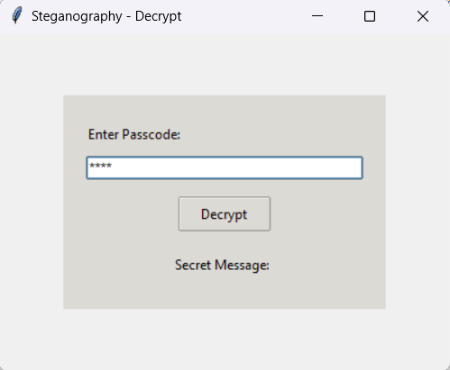
Results

Slide 8
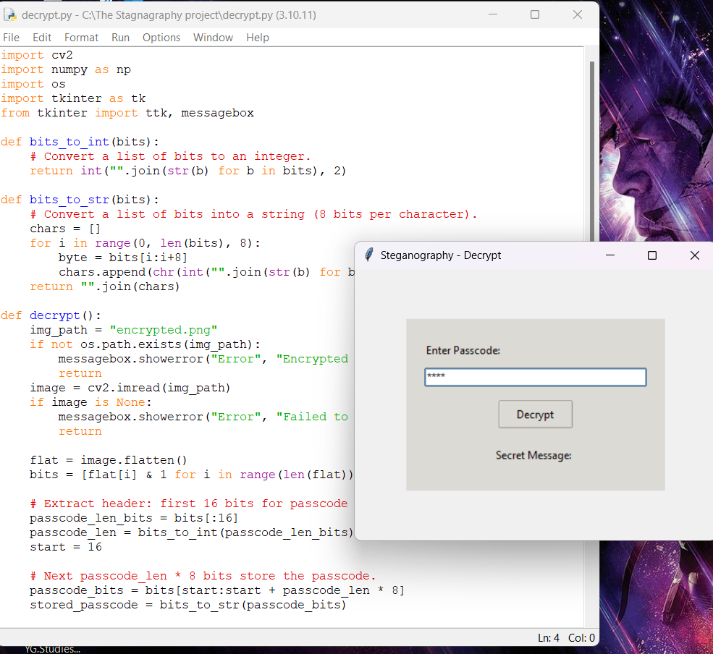

Output
Encrypted image

Slide 9
Conclusion
Our project successfully demonstrates a novel approach to data security by hiding information within an image using LSB steganography.
The technique is both secure and undetectable, thanks to embedding critical header information such as passcode and message lengths.
The user-friendly GUI enhances the accessibility of the method, making it a practical tool for secure communication.
This project contributes to the broader field of digital privacy and secure data transmission.

Slide 10
GitHub Link
https://github.com/YgRajput/IBM-Intern-Secure-Data-Hiding-in-Image.git

Slide 11
Future scope(optional)
Support for multiple image formats and higher resolution images.
Extend the approach to video steganography for dynamic data hiding.
Incorporate advanced encryption algorithms to further secure the hidden message.
Develop a web-based or mobile application for broader accessibility.
Explore automated detection and extraction tools for steganographic content.

Slide 12
THANK YOU

